Slide 1
Micro Credit
By Neha Gupta
21-05-202

Slide 2
Observations and Analysis:
Finding the type of problem
Analysis of columns
Finding the class is balance or imbalance
Analysis of data visualization
Removing the skewness
Finding the best model
Making the AUC ROC curve

Slide 3
Finding the type of problem
The problem was based on finding the loan defaulter so the problem was a logistic regression problem.

Slide 4
Analysis of columns
The "msisdn" has string and int data, so removed the column as it contains the mobile number of users. The mobile number is not affecting the model so can be removed.
The column "pcircle" is telecom circle, so removed the column as it does not effect the model performance.
The column "pdate" contains the date so applied feature engineering on the column to extract the data into int type and then dropped the "pdate" column.
The "pdate" column was extracted into the "months", "dates" and "years" column where the year column has unique value, so dropped the column.

Slide 5
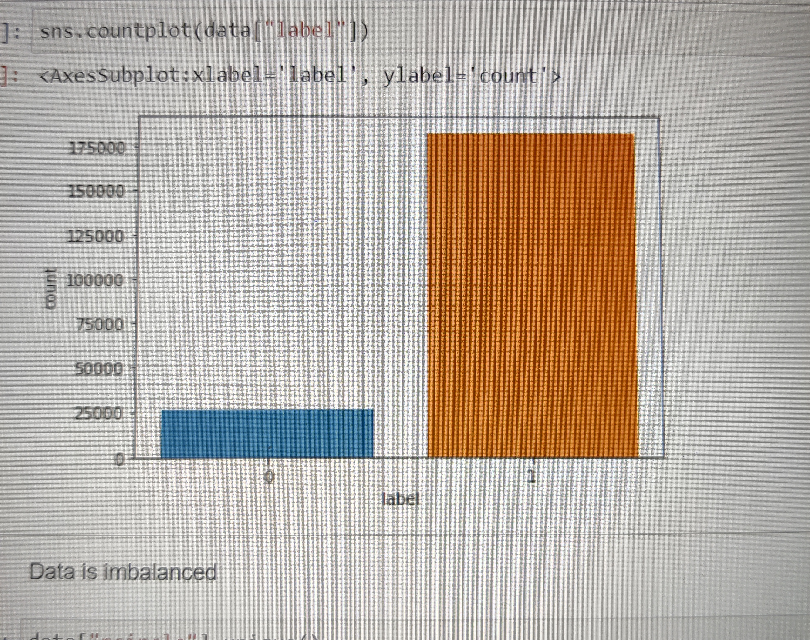
Finding the class is balance or imbalance
The class was imbalance

Slide 6
Analysis of data visualization
Applied standardscaller on the data to standardize it.
Learned the data description with data.describe() that how the data is behaving from column to column.
There are skewness present in the data as the standard deviation was too high for some columns.
There was no null values.
Applied IQR to remove skewness as zscore method did not worked.

Slide 7
Finding the best model
Applied the logistic regression and decision tree regression and found best accuracy in decision tree regression.

Slide 8
Thank You !!!!!

